Slide 1
Macroeconomic Predictions using Payments Data and
Machine Learning
By James T.E. Chapman and Ajit Desai
Discussion by Nicolas Woloszko
Advanced analytics: new methods and applications for macroeconomic policy, Bank of England, the European Central Bank, King’s College London and King’s Business School, November 5 2021.

Slide 2
A very interesting nowcasting exercise using a new source of data: payment data
The paper introduces a forecast of Canadian GDP and retail sales using payment data as well as traditional indicators
It runs a horse race of various ML models, an OLS and a DFM based on evaluation on a hold-out sample of 2 years of monthly observations(2019-2020)
The model using Gradient Boosting wins the horserace. The parameters are optimised using grid search and k-fold cross-validation.
The forecast works well for M+1 and M+2 (backcasting)
It uses SHAP to derive feature contributions and identify the main features.

Slide 3
ML at the frontier of macro
ML has been at the frontier of macro for at least 11 years now (eg Biau and D’Elia 2010) [it’s older than eg the synthetic control method (Abadie Gardeazabal 2003) !]
The literature has covered quite some ground:
  Whether ML can be used in macro (eg Biau and D’Elia 2010, Tiffin, 2016)
  Horse races based on off-the-shelf supervised algorithms (also with a pedagogical aim to introduce new tools in macro, eg Joseph 2017, Jung, Patnam and Ter-Martirosyan 2018)
  Why ML can work, what elements are specifically useful (eg Goulet Coulombe 2020[a], Bontempi 2017)
  The limits of supervised ML in macro, and improvemens on existing algorithms in order to better address the specific challenges in macro (eg Goulet Coulombe 2020 [b], Woloszko 2017, Joseph 2019)
The literature takes a new turn: high-frequency data.

Slide 4
Macro at the frontier of ML
Macro forecasters using ML face a number of questions at the frontier of research in ML:
  How to address concept drift (structural change)
  Asynchronous frequencies, the « ragged edge » problem
  ML for tabular data (XGBoost, Light GBM or deep learning)
There are still a number of research questions about interpretability
  What are the insights we can derive from using interpretability ? About the model, about the economy ? How certain are these insights (inference, Joseph 2020)
  Differential interpretability (eg different explanations derived from different models in the horse race, see Joseph 2020)
  How to group variables in meaningful « concepts » (Renard, Woloszko, Aigrain, Detyniecki, 2019)
Another important research topic is model evaluation…

Slide 5
Forecast simulations are constrained by the data reuse problem
Data re-use:
  Forecast simulations aim at estimating model performance based on a sample of observations (= the validation set)
  Research in forecasting is an adaptive process whereby researchers select a model, evaluate its performance using forecast simulation on a given validation set, and iterate based on previous results
  Data reuse = using the same validation set for developing and evaluating the model.
Data reuse can cause « over-fitting the validation set »
  Overfitting the training set = the in-sample performance diverges from the out-of-sample performance
  Over-fitting the validation set = the out-of-sample performance diverges from the “general” performance (over the underlying data distribution)
Also know as model selection bias:
  The best model, which is selected ex post, is more likely to fit the noise in the validation data
  Forecast simulations provide spurrious performance estimates…
  … which may lead to false discoveries by selecting models based on luck rather than skills (White, 2000).
Model selection bias is a bigger concern when:
  The validation set is small (here, N=24), or when the gist of the variance is driven by one given event
  The number of hyperparameters is large

Slide 6
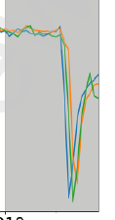
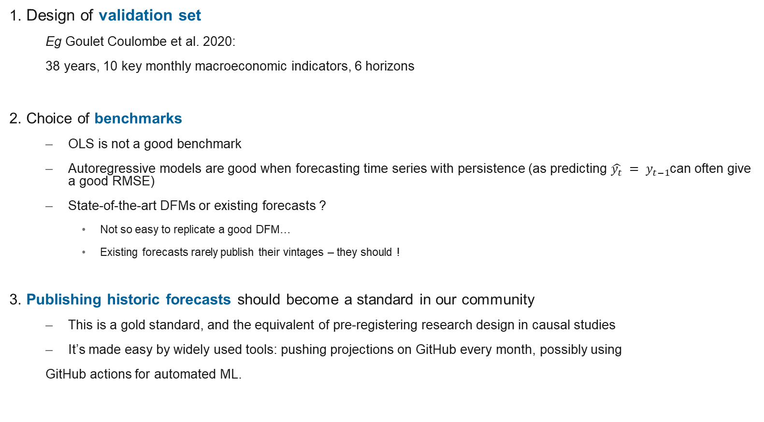
How to evaluate a forecasting algorithm ?
1. Design of validation set
  Eg Goulet Coulombe et al. 2020:
  38 years, 10 key monthly macroeconomic indicators, 6 horizons
2. Choice of benchmarks
  OLS is not a good benchmark
  Autoregressive models are good when forecasting time series with persistence (as predicting $\hat{y_{t}} = y_{t−1}$can often give a good RMSE)
  State-of-the-art DFMs or existing forecasts ?
    Not so easy to replicate a good DFM…
    Existing forecasts rarely publish their vintages – they should !
3. Publishing historic forecasts should become a standard in our community
  This is a gold standard, and the equivalent of pre-registering research design in causal studies
  It’s made easy by widely used tools: pushing projections on GitHub every month, possibly using
  GitHub actions for automated ML.
Time window
Countries
Target variables
Time horizons

